Slide 1
Notes:
What we have learnt so far.

Slide 2
Notes:
A whole new experience

Slide 4


Some everyday models
Notes:
Blueprint for space subdivision, but not useful to test sound
Airplane is to visualize how parts are related, but not useful for safety testing
Main purpose : simply things ,, add a wall to a blue print is much easier than in real life

Slide 5
Defining "model"
A model is a representation for a purpose
Notes:
● Representation: it stands for something in the real world
● Purpose: YOUR particular use for the model

Slide 6

What is the purpose ?
انتي جاية اشتغلي ايه؟

Slide 7


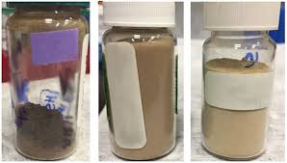

Slide 8
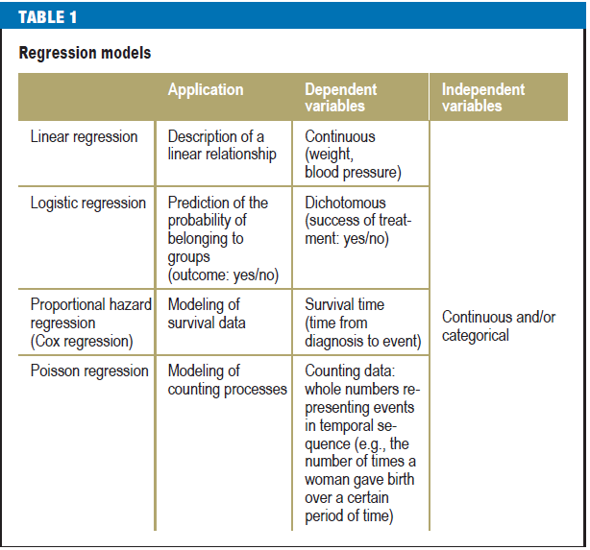

Slide 9


Slide 10
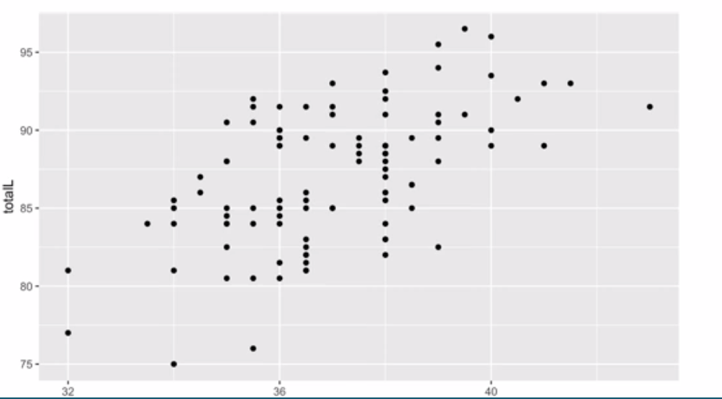

Slide 11
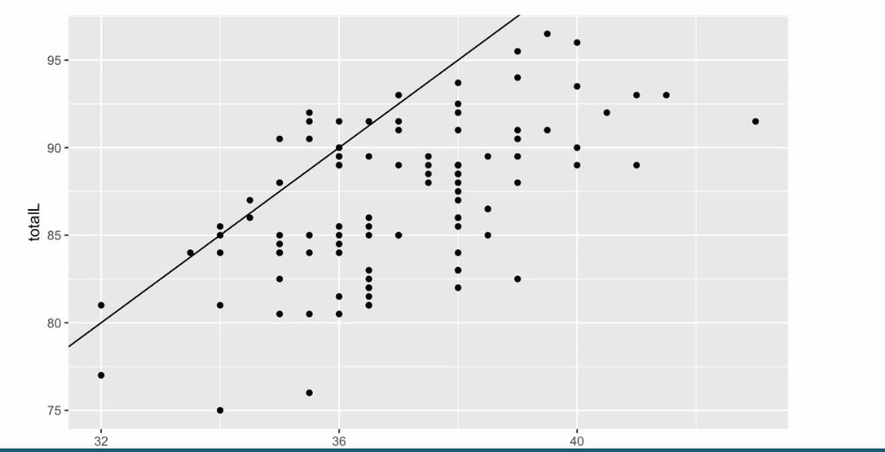
intercept = 0, slope = 2.5

Slide 12
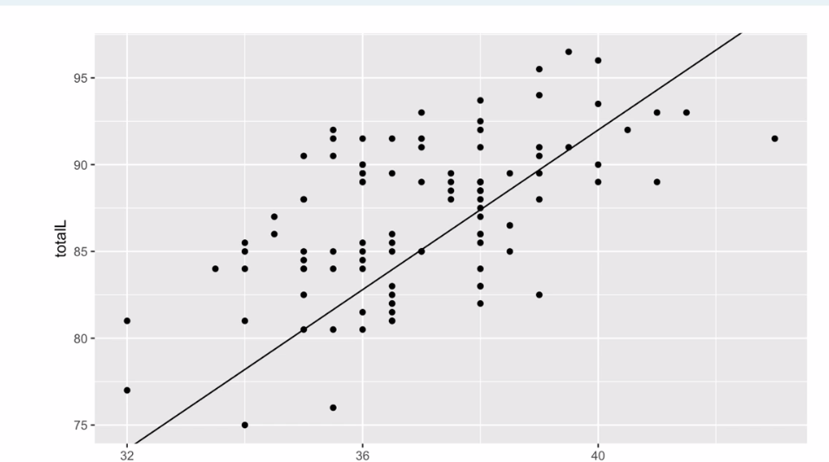
intercept = 0, slope = 1.7

Slide 13
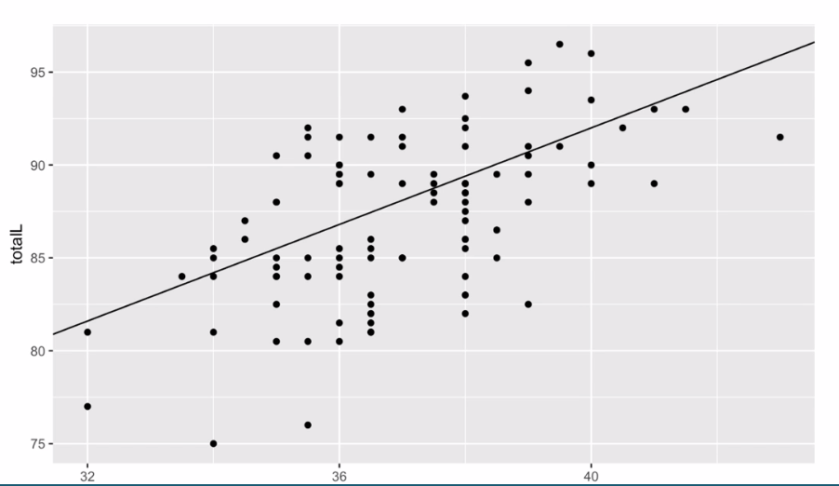
intercept = 40, slope = 1.3

Slide 14
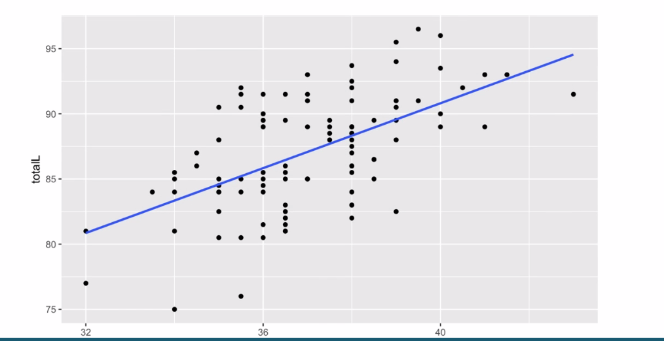
The "best" fit line

Slide 15
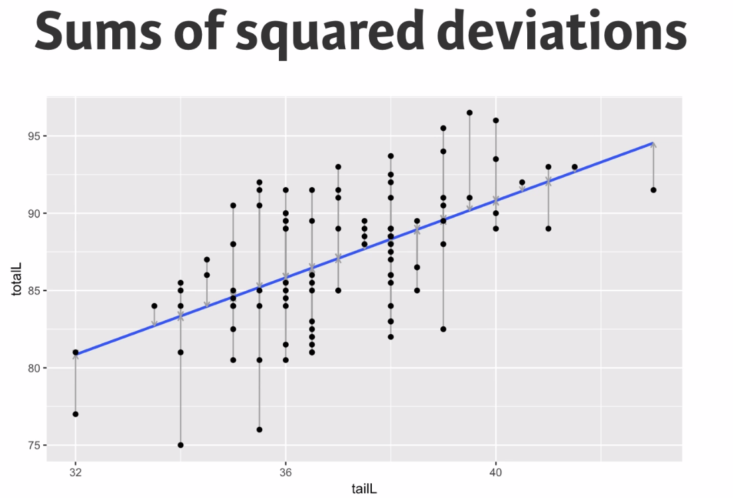

Slide 16
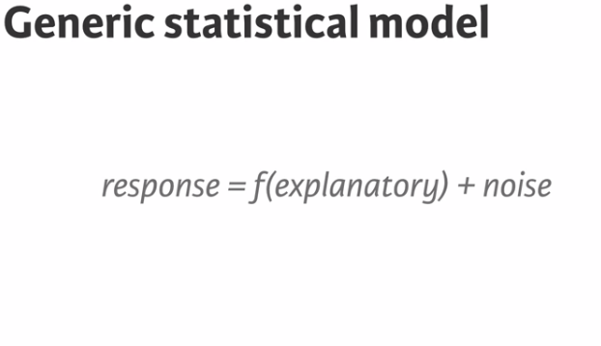


Slide 17
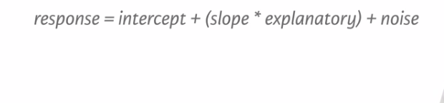
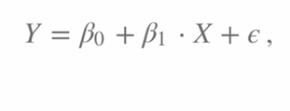

Slide 18
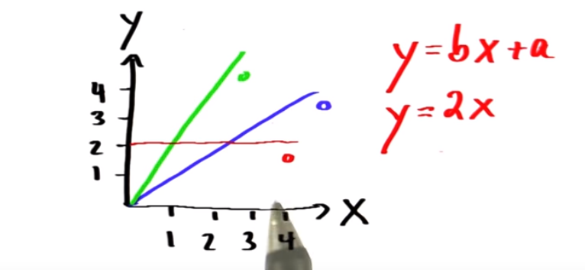

Slide 19
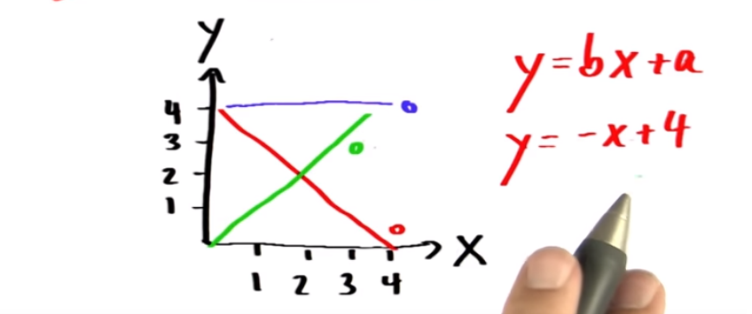

Slide 20
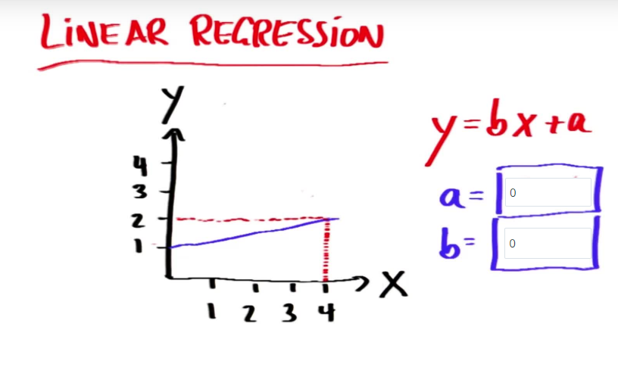

Slide 21
Why use multiple regression ?
Check simpson’s paradox data camp (multiple and logistic regression in R course). It illustrates the idea of confounding/moderation

Slide 22
How to interpret coefficients in multiple regression?
datacamp multiple and logistic regression course chapter 3 Conditional interpretation of coefficients video
For every unit change of x, .. Units of y after keeping a,b,c constant

Slide 23
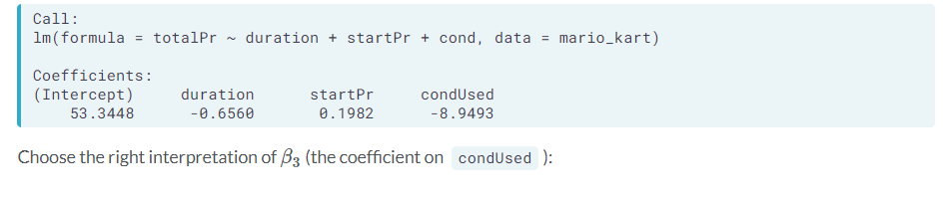
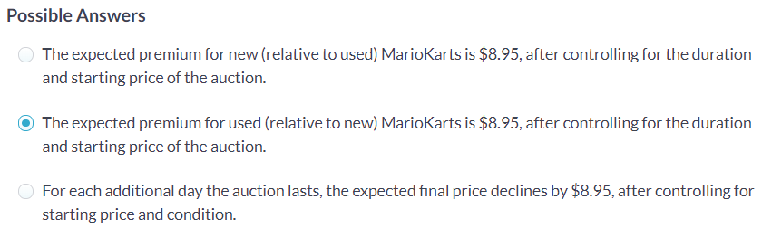
Question

Slide 24


Multiple regression
Notes:
More people cultivating opium, less petrol produced
More people consuming opium in china, less competition

Slide 25
requirements
number of observations should be at least 20 times greater than the number of variables under study

Slide 26
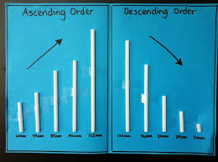
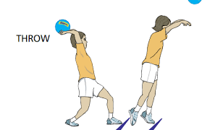
Adding predictors

Slide 27


Correlation vs causality
Direction
3rd variable
Adjustment ?
Notes:
Need RCT

Slide 28
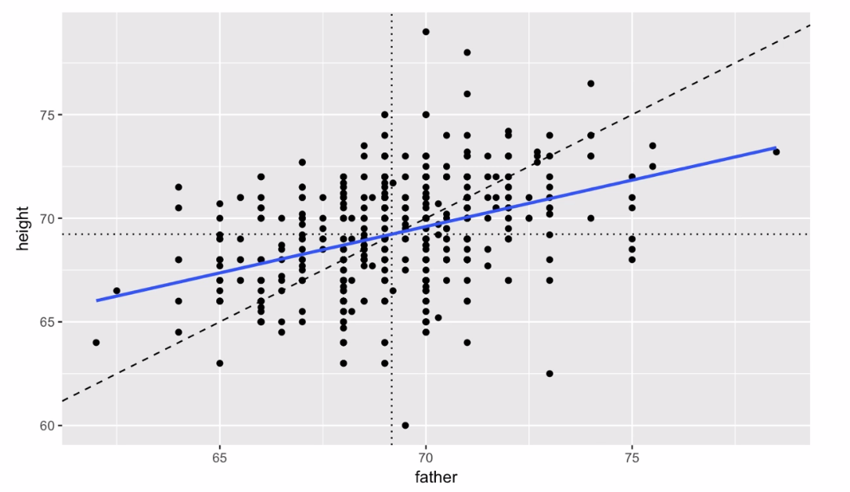
Regression towards the mean
Notes:
Height of son on the y axis
Height of father on x axis
Diagnoal indicates sons who are as tall as their fathers

Slide 29

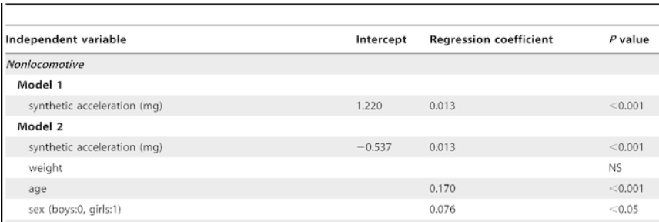

Model interpretation
Change in y for a unit change in x
Y = 47.64 + 14.93 × X
Notes:
For categorical:
Change in y for the change of x from … to …
The regression coefficient of 14.93 reflects
the fact that men are an average of 14.93 kg heavier
than women.

Slide 30
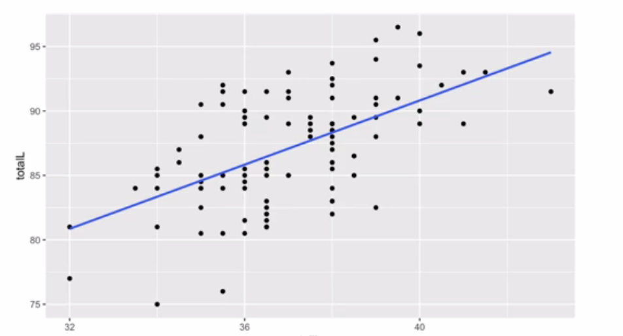
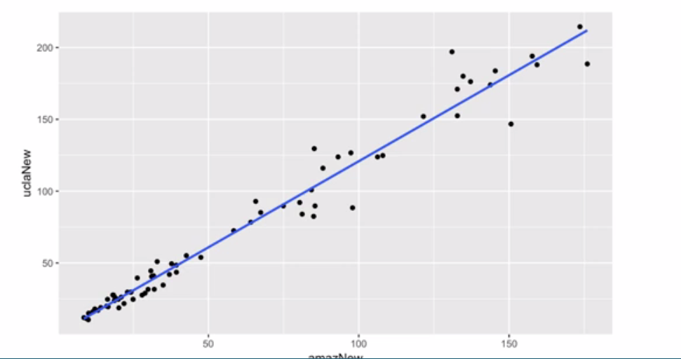
Model evaluation

Slide 31


Notes:
Misses often by a little bit
Is better than
A model that works perfectly most of the time, but occasionally is really bad

Slide 32

Overfitting
Notes:
This if we added number of predictors

Slide 33

Pressure can output a p-value من الشرخ الجواني))

Slide 34
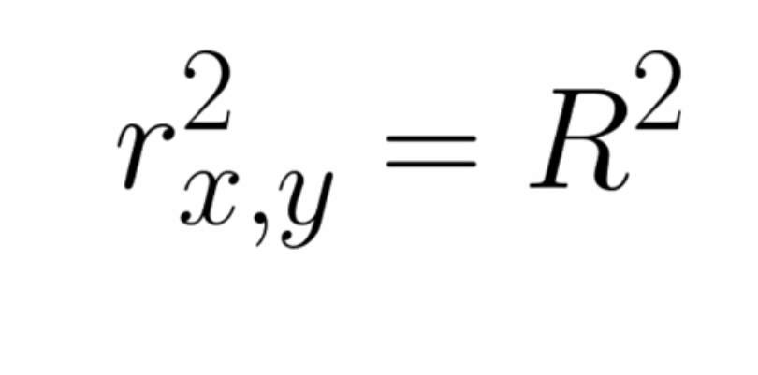

Slide 35

Notes:
Bivariate vs multiple variables … that’s why we need r small and r big

Slide 36


Adjusted R squared
Notes:
High R squared maybe due to over fitting or violate assumptions
Low R squared in a complex problem maybe useful

Slide 37
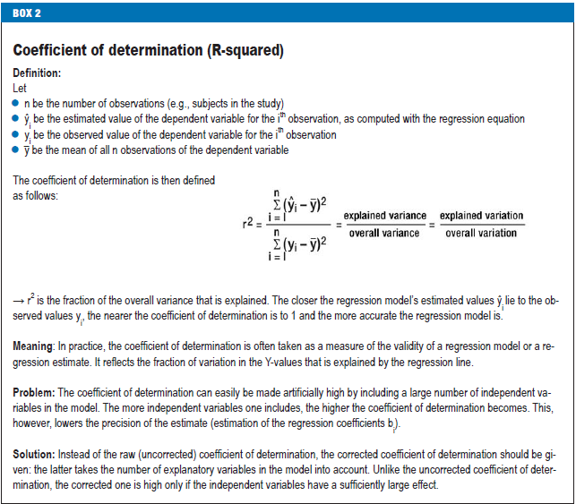

Slide 38
Linearity

Slide 39
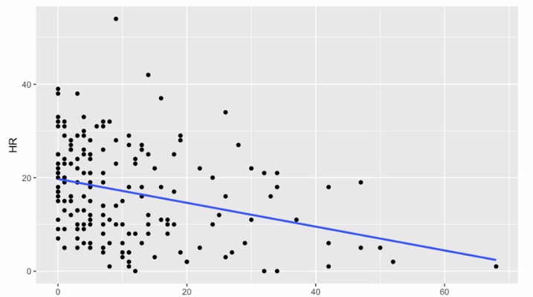
Leverage

Slide 40
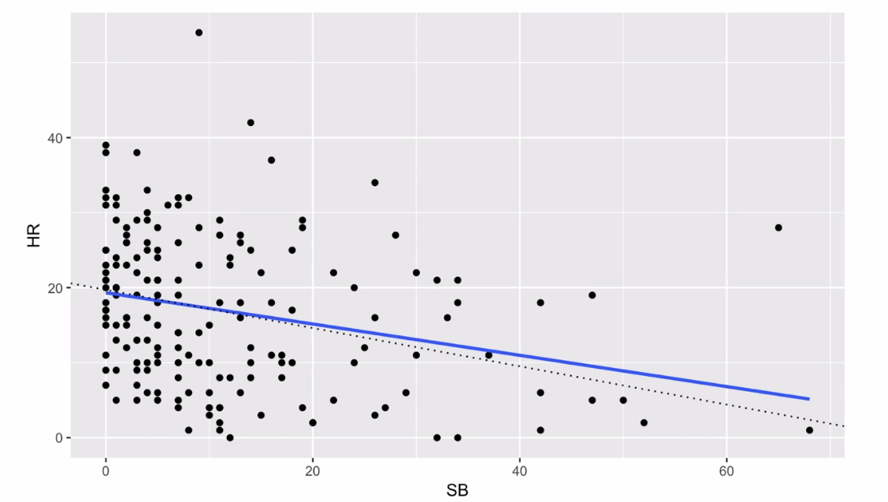
Influential points

Slide 41
Cook’s distance

Slide 42
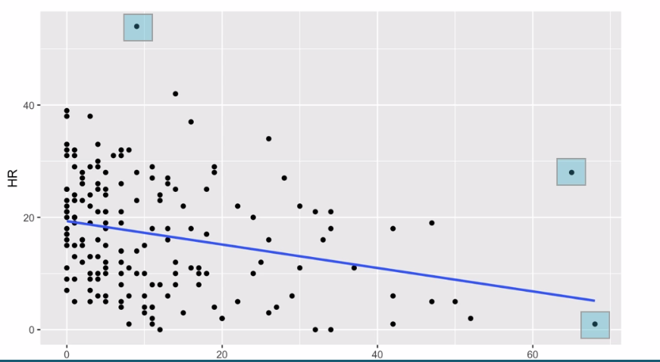

Slide 43
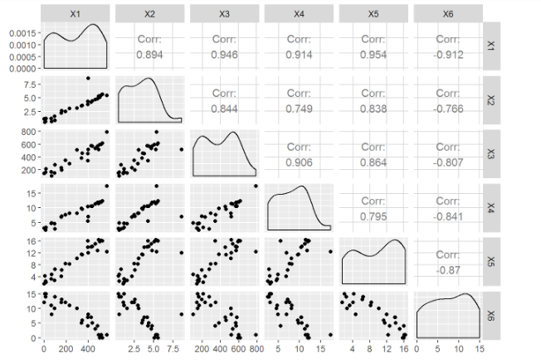
Multicolinearity

Slide 44
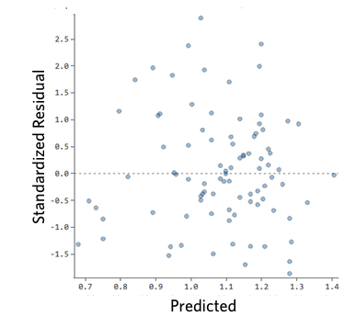
Notes:
positive values for the residual (on the y-axis) mean the prediction was too low, and negative values mean the prediction was too high; 0 means the guess was exactly correct.
they’re pretty symmetrically distributed, tending to cluster towards the middle of the plot (2) they’re clustered around the lower single digits of the y-axis (e.g., 0.5 or 1.5, not 30 or 150) (3) in general there aren’t clear patterns
http://docs.statwing.com/interpreting-residual-plots-to-improve-your-regression

Slide 45
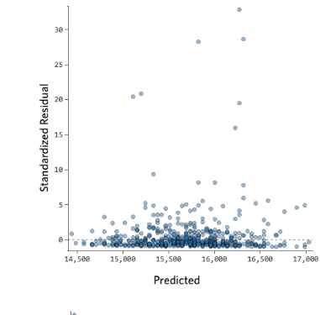

Slide 46
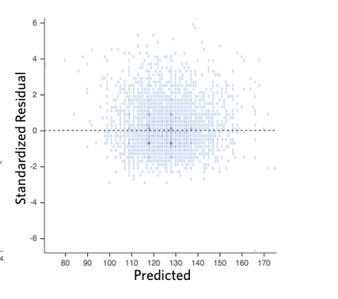

Slide 47
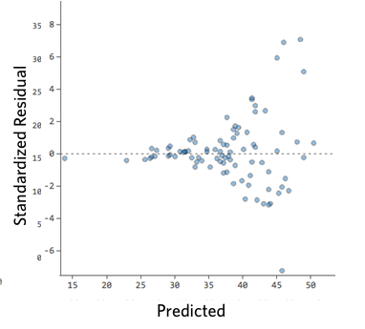

Slide 48
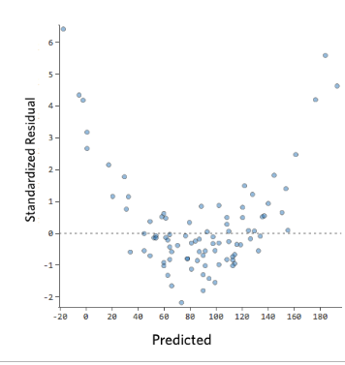
Notes:
These plots aren’t evenly distributed vertically, or they have an outlier, or they have a clear shape to them.
If you can detect a clear pattern or trend in your residuals, then your model has room for improvement.

Slide 49
Notes:
/

Slide 50


What to do ?

Slide 51
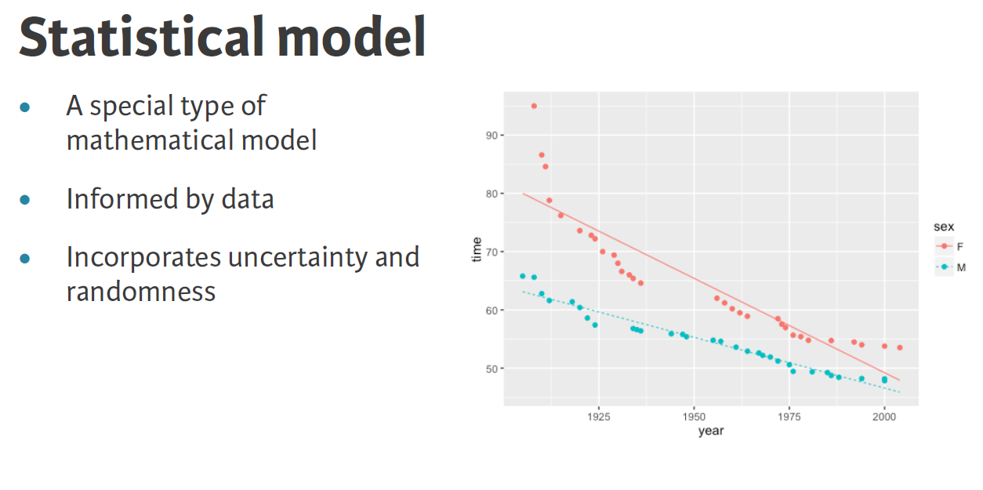

Slide 52
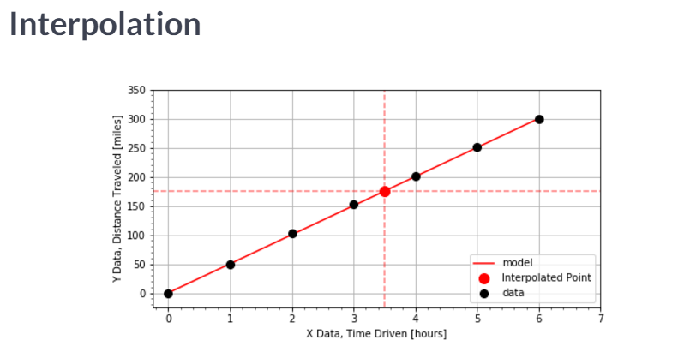

Slide 53
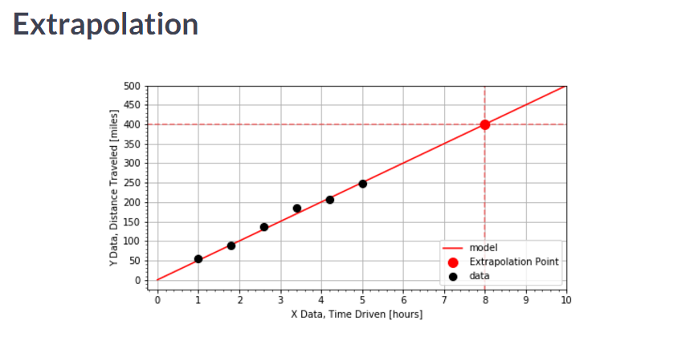

Slide 54

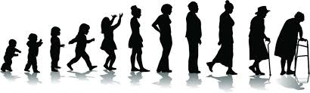

Medical data

Slide 55
Which regression model to choose?
Hours spent studying
Alive or dead
Time to death
Vehicle speed
Height of children
Chemotherapy toxicity
Time spent before teacher enters class

Slide 56
Applications
A linear regression model can be used,
for instance, to determine the optimal values for respi -
ratory function tests depending on a person’s age,
body-mass index (BMI), and sex. Comparing a
patient’s measured respiratory function with these computed
optimal values yields a measure of his or her state
of health.

Slide 59
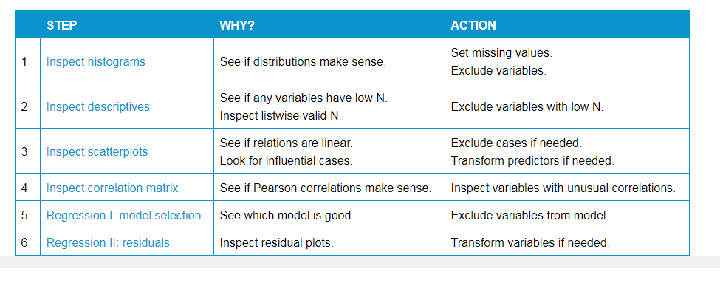

Slide 60
References
Linear Regression Analysis
Part 14 of a Series on Evaluation of Scientific Publications
Udacity statistics, the science of decisions course
Datacamp correlation and regression course
Datacamp statistical modeling part 1
https://www.spss-tutorials.com/spss-simple-linear-regression-tutorial/

